Slide 1


Project Based Learning-II (210258)
Bhujbal Knowledge City
Institute of Engineering
Department of Computer Engineering
A Project Presentation on Topic
Weather Prediction System
:: Presented By ::
:: Under the Guidance of ::
Patel Harsh Prashant
Patel Neer Ashwin
Patil Shivam Hambirrao
Patil Sneha Sunil
Pawar Aarya Prashant
Prof. Shraddha Pawar
Students from SE Computer, Semester-II, A.Y.-2023-24

Slide 2
Contents
Bhujbal Knowledge City
Institute of Engineering
Department of Computer Engineering
Abstract
Introduction
Literature Survey
Problem Statement
Motivation
Scope of the Project
Objectives
Requirement Analysis
Software Requirement Specification
Methodology/ Proposed System Block Diagram
Software and Hardware Requirements
Implementation
Results/Test Cases
Challenges Faced
Conclusion and Future Scope
References

Slide 3
Abstract
Bhujbal Knowledge City
Institute of Engineering
Department of Computer Engineering
In an era of increasing climate variability and extreme weather events, accurate weather prediction is important for various sectors ranging from agriculture to disaster management. Holding advancements in data science and machine learning, this project aims to enhance traditional weather prediction methods by harnessing diverse datasets and sophisticated algorithms.
Through this project, we seek to improve the accuracy of weather forecasts, thereby aiding decision-making processes and enhancing preparedness for weather-related challenges.

Slide 4
Introduction
Bhujbal Knowledge City
Institute of Engineering
Department of Computer Engineering
Weather prediction plays a vital role in our daily lives, influencing everything from the clothes we wear to the activities we plan. However, despite significant advancements in technology, predicting weather accurately remains a complex and challenging task. Traditional forecasting methods, often encounter limitations in capturing the nuances of rapidly changing weather patterns.
Recognizing the need for more precise and reliable forecasts, this project tries to push the boundaries of weather prediction by using data science techniques. By harnessing vast amounts of dataset, we aim to develop predictive models capable of offering insights into future weather conditions with heightened accuracy.
Through this interdisciplinary approach, we seek to not only improve the precision of weather forecasts but also provide valuable insights into the dynamics of weather systems.

Slide 5
Literature Survey
Bhujbal Knowledge City
Institute of Engineering
Department of Computer Engineering
No literature….. No survey……….

Slide 6
Problem Statement
Bhujbal Knowledge City
Institute of Engineering
Department of Computer Engineering
To develop and implement a data-driven approach with machine learning techniques to enhance the accuracy and reliability of weather forecasts. By addressing the limitations of existing methods and harnessing diverse datasets, including atmospheric data, and historical weather records, we seek to improve the precision of weather predictions, ultimately aiding decision-making processes and enhancing preparedness for weather-related challenges.

Slide 7
Motivation
Bhujbal Knowledge City
Institute of Engineering
Department of Computer Engineering
The motivation behind this project lies in the critical importance of accurate weather prediction in various aspects of life. Weather impacts agriculture, transportation, energy production, disaster management, and public safety, among others. Traditional weather prediction methods often struggle to capture the complexity and rapid changes in weather patterns, leading to uncertainties and potential risks for individuals and communities.
By harnessing advanced data science techniques, including machine learning algorithms, we aim to address these challenges and improve the accuracy and reliability of weather forecasts. This project thus seeks to contribute to the advancement of weather forecasting technology, ultimately benefiting society by providing more reliable predictions and better preparedness for weather-related challenges.

Slide 8
Scope of the Project
Bhujbal Knowledge City
Institute of Engineering
Department of Computer Engineering
The scope of this project encompasses the development and implementation of a data-driven approach to enhance weather prediction accuracy. This includes collecting and preprocessing diverse datasets such as satellite imagery, atmospheric data, and historical weather records.
Machine learning algorithms will be employed to analyze these datasets and use the predictive models capable of forecasting weather conditions with greater precision. The project also involves evaluating the performance of these models against traditional forecasting. Additionally, considerations will be made for the scalability and usability of the developed models, by showing the various statistical data results obtained after the execution.

Slide 9
Objectives
Bhujbal Knowledge City
Institute of Engineering
Department of Computer Engineering
To understand the concept of machine learning and how it is implemented and used.
To understand the basic idea or concept behind the weather prediction models and its working with the given datasets.
To understand the machine learning model and the statistical concepts used for predicting the weather results.
To study and work with the Python in-built libraries and frameworks for machine learning models and their basic functionalities.

Slide 10
Requirement Analysis
Bhujbal Knowledge City
Institute of Engineering
Department of Computer Engineering
Data Resources:
A dataset is required for analysis of previous data and hence to calculate the insights.
Machine Learning Models:
Identify the appropriate machine learning algorithms for weather prediction, considering factors such as accuracy, scalability, and computational efficiency.
Integration:
Identify any external systems or APIs that need to be integrated with the weather prediction system, such as weather data APIs, geographic information systems (GIS), or third-party visualization tools.

Slide 11
Software Requirement Specification
Bhujbal Knowledge City
Institute of Engineering
Department of Computer Engineering
The weather prediction system tries to predict the weather with a greater accuracy.
Functional Requirements:
An CSV file of dataset,
Python interpreter,
Libraries like pandas, numpy, matplotlib and seaborn,
APIs for web scraping the real-time information.
Non-Functional Requirements:
Performance: The system should to give results in 5 seconds after the request is sent.
Usability: the user interface should be easily accessible and familiar with user.
Compatibility: The system should be compatible with commonly used web- browsers.

Slide 12
Methodology/Proposed System Block Diagram
Bhujbal Knowledge City
Institute of Engineering
Department of Computer Engineering
Defining Objectives and Scope:
This is the initial step while building any machine learning model. Here we clearly define the parameters to be considered during the model training and insights prediction.
We have considered the parameters like Temperature (ºC), Dew Point (ºC), Relative Humidity(%), Wind Speed(km/h), Visibility(km) and Atmospheric Pressure (kPa). Depending on this values, the result decides the weather.
The influence/effect of each parameters on the final results depends on the importance of each parameter in affecting or changing the weather. The system also shows a graph about the importance of each factor on the result.

Slide 13
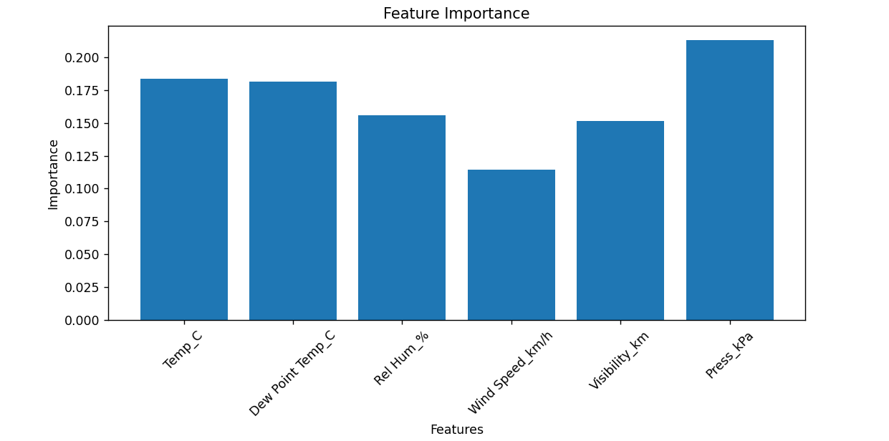
Methodology/Proposed System Block Diagram
Bhujbal Knowledge City
Institute of Engineering
Department of Computer Engineering
Defining Objectives and Scope:

Slide 14
Methodology/Proposed System Block Diagram
Bhujbal Knowledge City
Institute of Engineering
Department of Computer Engineering
Dataset Creation:
The dataset is created for training the ML model. The dataset consist of previous information about the certain problem. Here we have collected the data for all the parameters from the year 2012 to year 2013.
This information has hourly report of all the parameters, which leads to total of 8,760 data to analyse. The dataset is mostly created on an excel sheet with ‘.csv’ extension making it ‘Comma Separated Values file. This files differentiate the data with comma in between them. This helps in analysing the data properly.
For collection of data various platforms are available, and for real-time access to the weather we can use various APIs or web scraping for creating dataset.

Slide 15
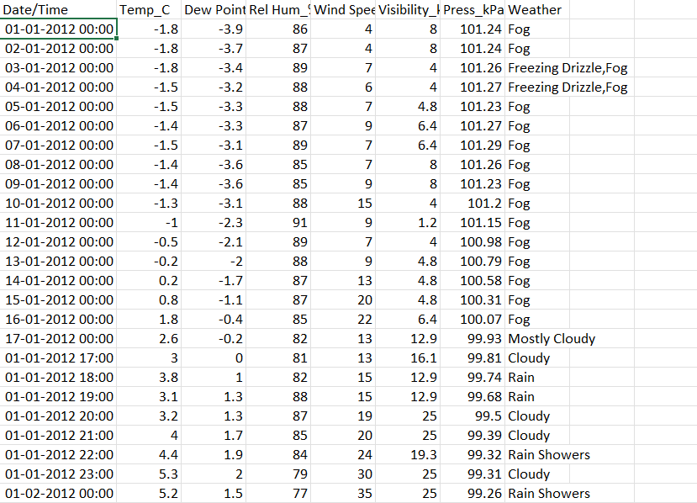
Methodology/Proposed System Block Diagram
Bhujbal Knowledge City
Institute of Engineering
Department of Computer Engineering
Dataset Creation:

Slide 16
Methodology/Proposed System Block Diagram
Bhujbal Knowledge City
Institute of Engineering
Department of Computer Engineering
Data Preprocessing:
Data pre-processing is the most important part of this project. As the model takes up only the values/integers to predict the results. Hence, the string or characters data(categorical data) needs to be converted into the integers. The RandomForest encodes the data into labels(certain integer values) and hence the data is fitted in the model.
Here, the RandomForest algorithm uses the Label Encoding method. In this, the integers are assigned with the integers like 0,1 or 2, depending upon the rank or meaningful sequence of those categories.

Slide 17
Methodology/Proposed System Block Diagram
Bhujbal Knowledge City
Institute of Engineering
Department of Computer Engineering
Model Selection and Training:
We have to choose an appropriate machine learning algorithms or models for weather prediction, considering factors such as:
Regression models (e.g., linear regression, decision trees)
Time-series forecasting models (e.g., ARIMA, LSTM)
Ensemble methods (e.g., random forests, gradient boosting)
Next step is to train the selected models using the training dataset, optimizing hyperparameters as needed through techniques such as cross-validation or grid search.
Evaluate the trained models using the validation dataset, assessing performance metrics such as mean absolute error, root mean squared error, or coefficient of determination (R-squared).

Slide 18
Methodology/Proposed System Block Diagram
Bhujbal Knowledge City
Institute of Engineering
Department of Computer Engineering
RandomForest Model:
The accuracy and performance of results depends upon the ML models we choose. In this system, we have used the RandomForest. RandomForest is a popular ensemble learning method that combines multiple decision trees to improve predictive performance and reduce overfitting.
For example, while training the model, various decision trees are used for different parts of dataset, which analyzes that data and gives the respective results. The result with highest frequency is considered as the result of the whole dataset.
Hence, while testing or predicting, the dataset will be fitted into different trees, then the result with highest frequency will be considered as the final result.

Slide 19
Methodology/Proposed System Block Diagram
Bhujbal Knowledge City
Institute of Engineering
Department of Computer Engineering
Why The RandomForest Model ?:
Ensemble Learning: Helps to reduce the risk of inaccurate results.
Handling Non-linear Relationships: Handles the non-linear input features and the target variables.
Handling Missing Values: It simply ignores missing values or make decisions based on available data.
Tuning and Hyperparameters: Model can be adjusted to improve performance, such as number od trees.
Generalization: Works well on the new and unseen dataset.
Model Interpretability: How the prediction is made, feature importance and decision paths can be studied easily.

Slide 20
Methodology/Proposed System Block Diagram
Bhujbal Knowledge City
Institute of Engineering
Department of Computer Engineering
User Information
Data Transformation and Combination
Storage Data
Data Mining Technique
Decision Tree
Weather Prediction

Slide 21
Software and Hardware Requirements
Bhujbal Knowledge City
Institute of Engineering
Department of Computer Engineering
SOFTWARE REQUIREMENTS:
Python 3.12.2 and IDE (like jupyter notebook or VScode)
Libraries like numpy, pandas, matplotlib.
Machine learning framework library: Scikit-learn
Microsoft Excel: for storing the dataset.
APIs and other External Services.
HARDWARE REQUIREMENTS:
CPU: multi-core processor with high clock speed.
Storage/Memory: SSD storage, RAM above from 8GB.
Networking: to connect with real-time weather information.

Slide 22
Implementation
Bhujbal Knowledge City
Institute of Engineering
Department of Computer Engineering
Python Code:
import pandas as pd
import numpy as np
import matplotlib.pyplot as plt
from sklearn.model_selection import train_test_split
from sklearn.ensemble import RandomForestClassifier
from sklearn.metrics import accuracy_score, classification_report, confusion_matrix
# Load the dataset
data = pd.read_csv('Dataset11-Weather-Data.csv')
# Preprocessing
# Convert categorical weather types into standard categories
def get_weather_category(weather):
if 'Fog' in weather and 'Rain' in weather:

Slide 23
Implementation
Bhujbal Knowledge City
Institute of Engineering
Department of Computer Engineering
return 'RAIN+FOG'
elif 'Snow' in weather and 'Rain' in weather:
return 'SNOW+RAIN'
elif 'Snow' in weather:
return 'SNOW'
elif 'Rain' in weather:
return 'RAIN'
elif 'Fog' in weather:
return 'FOG'
elif 'Clear' in weather:
return 'CLEAR'
elif 'Cloudy' in weather:
return 'CLOUDY'
else:
return 'OTHER'
data['Weather_Category'] = data['Weather'].apply(get_weather_category)

Slide 24
Implementation
Bhujbal Knowledge City
Institute of Engineering
Department of Computer Engineering
# Split data into features (X) and target variable (y)
X = data[['Temp_C', 'Dew Point Temp_C', 'Rel Hum_%', 'Wind Speed_km/h', 'Visibility_km', 'Press_kPa']]
y = data['Weather_Category']
# Split data into training and testing sets
X_train, X_test, y_train, y_test = train_test_split(X, y, test_size=0.2, random_state=42)
# Model training
model = RandomForestClassifier(n_estimators=100, random_state=42)
model.fit(X_train, y_train)
# Model evaluation
y_pred = model.predict(X_test)
accuracy = accuracy_score(y_test, y_pred)
print("Accuracy:", accuracy)
print("\nClassification Report:")
print(classification_report(y_test, y_pred))
print("\nConfusion Matrix:")
print(confusion_matrix(y_test, y_pred))

Slide 25
Implementation
Bhujbal Knowledge City
Institute of Engineering
Department of Computer Engineering
# Example of weather prediction
example_features = [[15.0, 10.0, 70, 20, 10, 100]]
# Adjust feature values here
predicted_weather_category = model.predict(example_features)
print("\nPredicted Weather Category:", predicted_weather_category[0])
# Visualization
# Plot feature importance
feature_importance = model.feature_importances_
feature_names = X.columns
plt.figure(figsize=(10, 5))
plt.bar(feature_names, feature_importance)
plt.xlabel('Features')
plt.ylabel('Importance')
plt.title('Feature Importance')
plt.xticks(rotation=45)
plt.show()

Slide 26
Results/Test Cases
Bhujbal Knowledge City
Institute of Engineering
Department of Computer Engineering
Test Cases :
Temp_C =15, Dew Point Temp_C =10, Rel Humidity_%=70, Wind Speed_km/h =20, Visibility_km =10, Press_kPa=100:
Temp_C =15, Dew Point Temp_C =10, Rel Humidity_%=70, Wind Speed_km/h =20, Visibility_km =10, Press_kPa=100:
Temp_C =15, Dew Point Temp_C =10, Rel Humidity_%=70, Wind Speed_km/h =20, Visibility_km =10, Press_kPa=100:

Slide 27
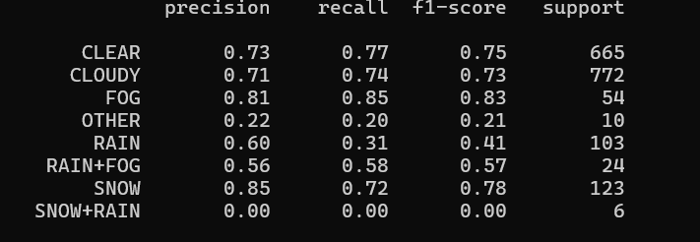

Results/Test Cases
Bhujbal Knowledge City
Institute of Engineering
Department of Computer Engineering

Slide 28
Challenges Faced
Bhujbal Knowledge City
Institute of Engineering
Department of Computer Engineering
To maintain the accuracy of the model.
To train the model and implement the project.
To find literature for giving in-depth information about the concepts.

Slide 29
Conclusion and Future Scope
Bhujbal Knowledge City
Institute of Engineering
Department of Computer Engineering
To develop a fully functional and interactive app for the user.
To get trustworthy APIs to get real-time updates about the current changes in weather.
To work with real-time data and keep the prediction model updating the information from time-to-time.
To decrease the response time and increasing number of decision trees.

Slide 30
References
Bhujbal Knowledge City
Institute of Engineering
Department of Computer Engineering
https://www.researchgate.net/
https://www.datacamp.com/
‘A Multi-class Classification Approach for Weather Forecasting with Machine Learning Techniques’ by Elias Dritsas, Maria Trigka and Phivos Mylonas introduced at 17th International Workshop on Semantic and Social Media Adaptation & Personalization (SMAP).
‘Weather Forecast Prediction: An Integrated Approach for Analyzing and Measuring Weather Data’ by Munmun Biswas, Tanni Dhoom and Sayantanu Barua on December 2018 in International Journal of Computer Applications.

